Slide 1
Chinatowns in
Latin America
By Noreen Naseem Rodríguez
This slidedeck contains open access images for AAVEd Bite-Sized Lessons for first and sixth grades. Links for all images can be found in the speaker notes.

Slide 2
1st Grade

Slide 3
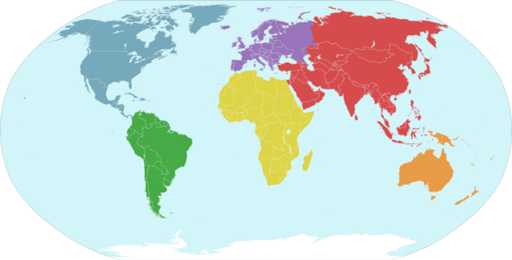
Notes:
This map is open access from Wikimedia Commons https://commons.wikimedia.org/wiki/File:Continents_wikivoyage_nl.png

Slide 4
North America
Europe
Asia
Africa
South America
Australia
Antarctica
Notes:
This map is open access from Wikimedia Commons https://commons.wikimedia.org/wiki/File:Continents_wikivoyage_nl.png

Slide 5
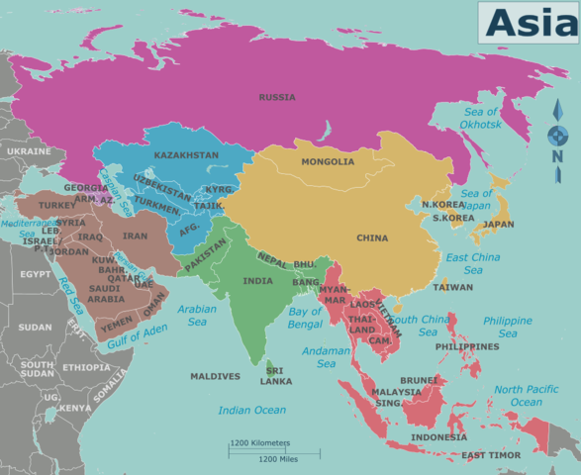
Notes:
This map is open access from Wikimedia Commons https://commons.wikimedia.org/wiki/File:Map_of_Asia.png

Slide 6
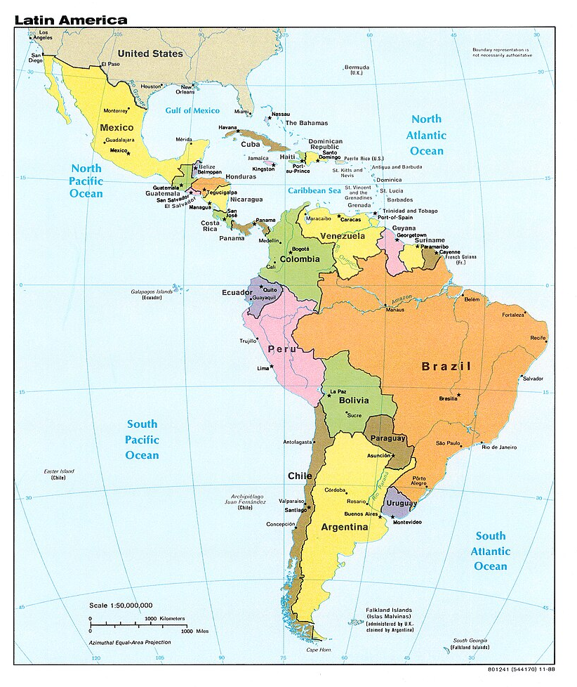
Notes:
This map is open access from Wikimedia Commons https://commons.wikimedia.org/wiki/File:Latin_America_-_DPLA_-_0e878dd24c023384c2b490af35d9d276.jpg

Slide 7
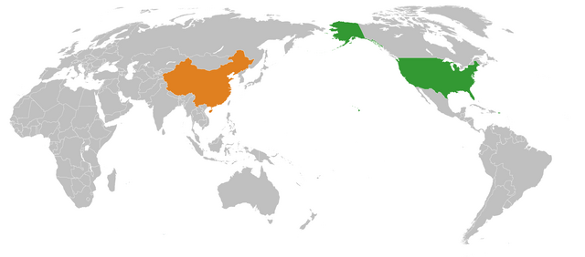
Notes:
This map is open access from Wikimedia Commons https://commons.wikimedia.org/wiki/File:Second_Cold_War_America-China_Pacific_Locator.png

Slide 8
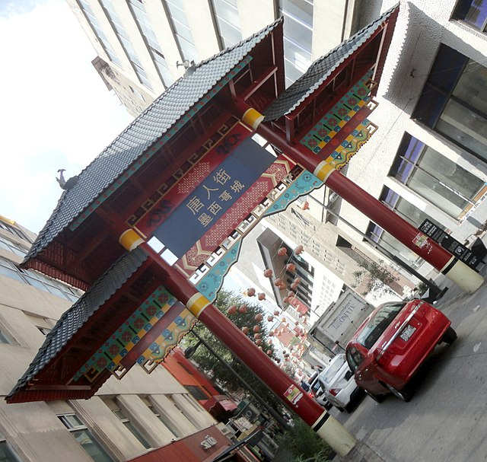
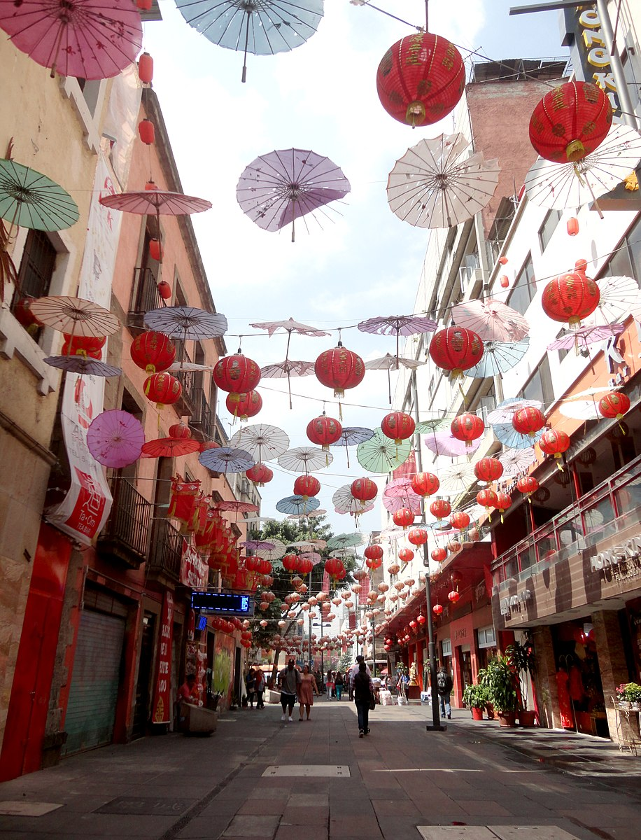
Barrio Chino, Mexico City, Mexico
Photos by Juan Carlos Fonseca Mata
Notes:
These images are open access from Wikimedia Commons: https://commons.wikimedia.org/wiki/File:Paifang_del_Barrio_Chino,_Calle_de_Dolores,_Ciudad_de_M%C3%A9xico.jpg
https://commons.wikimedia.org/wiki/File:Barrio_Chino,_Ciudad_de_M%C3%A9xico_-_Adornos.jpg

Slide 9
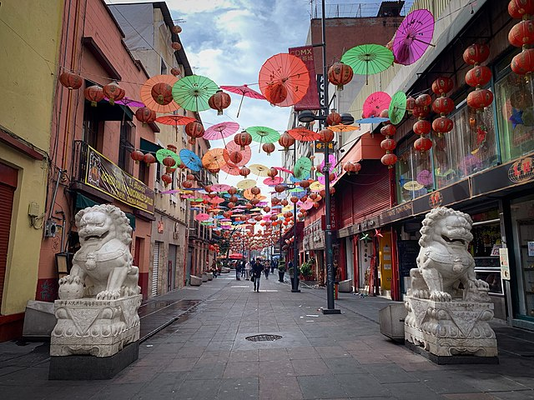
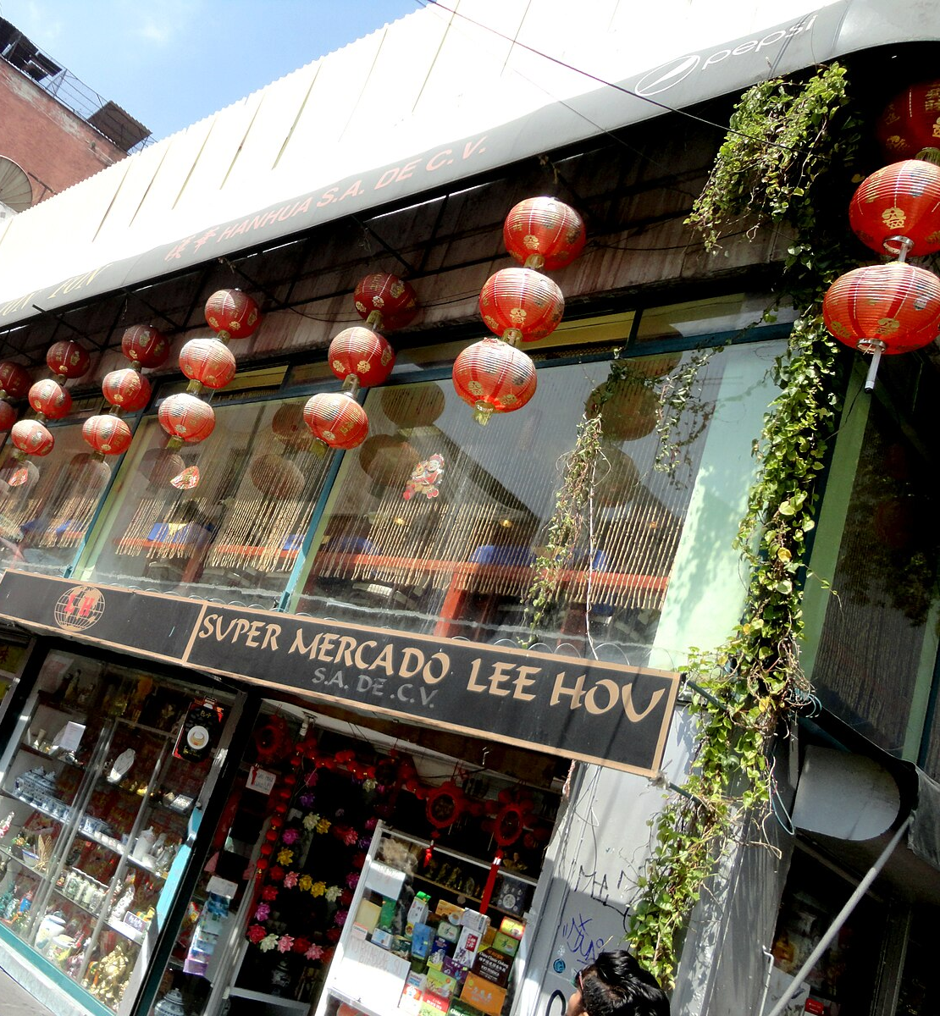
Barrio Chino, Mexico City, Mexico
Photos by Beatriz Zarzosa and Juan Carlos Fonseca Mata
Notes:
These images are open access from Wikimedia Commons:
https://commons.wikimedia.org/wiki/File:Barrio_Chino_CIudad_de_Mexico.jpg

Slide 10
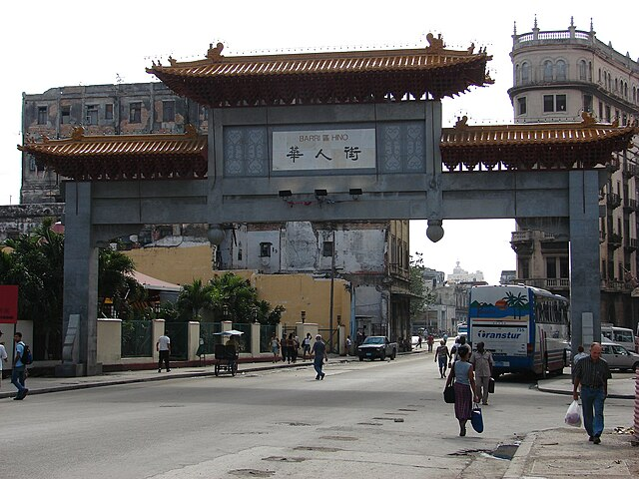
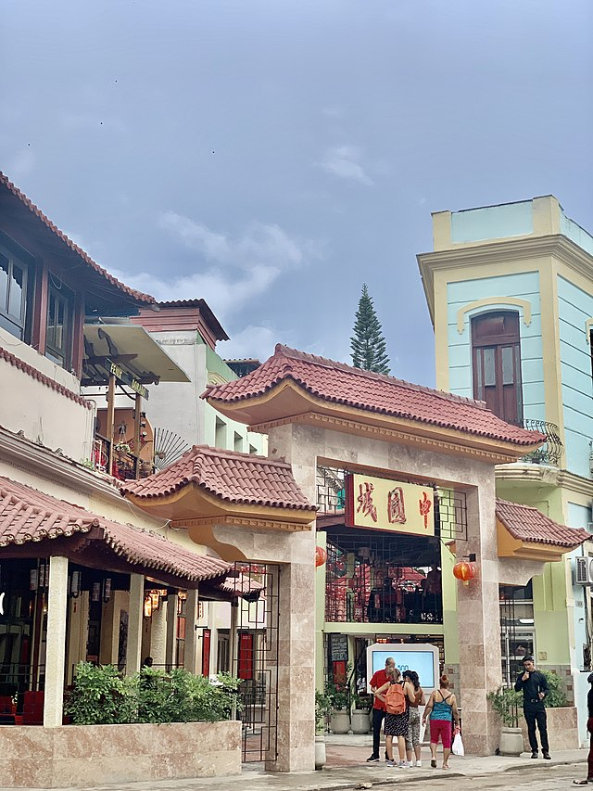
Barrio Chino, Havana, Cuba
Photos by Delznaga and Tacorontey
Notes:
These images are open access from Wikimedia Commons: https://commons.wikimedia.org/wiki/File:Puerta_de_los_Dragones_-_Barrio_Chino_de_La_Habana.JPG https://commons.wikimedia.org/wiki/File:Havana,_Cuba_Chinatown.jpg

Slide 11
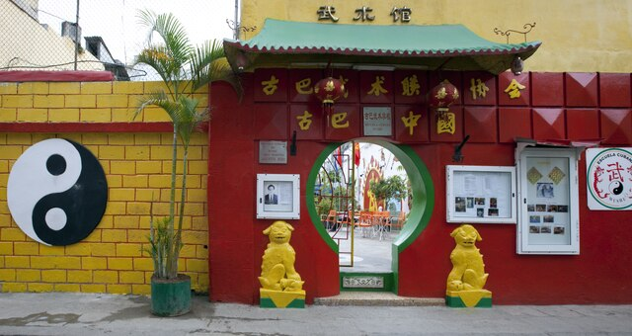
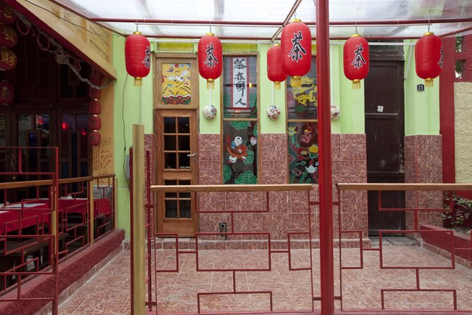
Barrio Chino, Havana, Cuba
Photos by Carol M. Highsmith
Notes:
These images are open access from Wikimedia Commons: https://commons.wikimedia.org/wiki/File:Barrio_Chino-_Chinatown_in_the_Caribbean,_Havana,_Cuba_LCCN2010638965.tif https://commons.wikimedia.org/wiki/File:Barrio_Chino-_Chinatown_in_the_Caribbean,_Havana,_Cuba_LCCN2010638967.tif

Slide 12
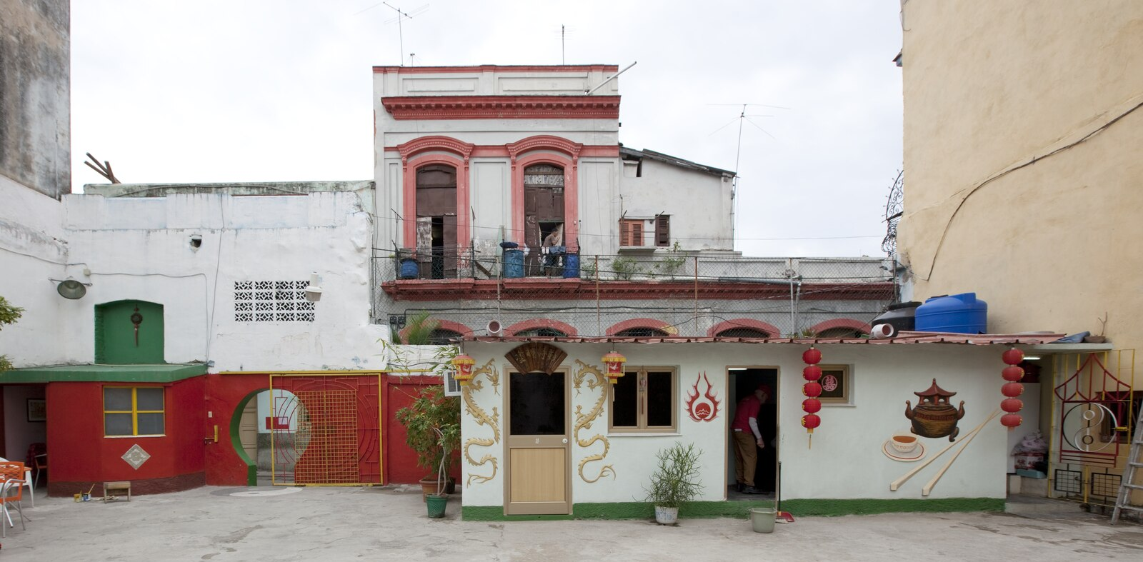
Barrio Chino, Havana, Cuba
Photo by Carol M. Highsmith
Notes:
These images are open access from Wikimedia Commons: https://commons.wikimedia.org/wiki/File:Barrio_Chino-_Chinatown_in_the_Caribbean,_Havana,_Cuba_LCCN2010638969.tif

Slide 13
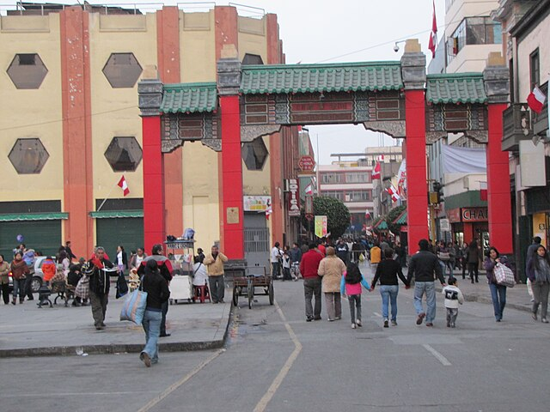
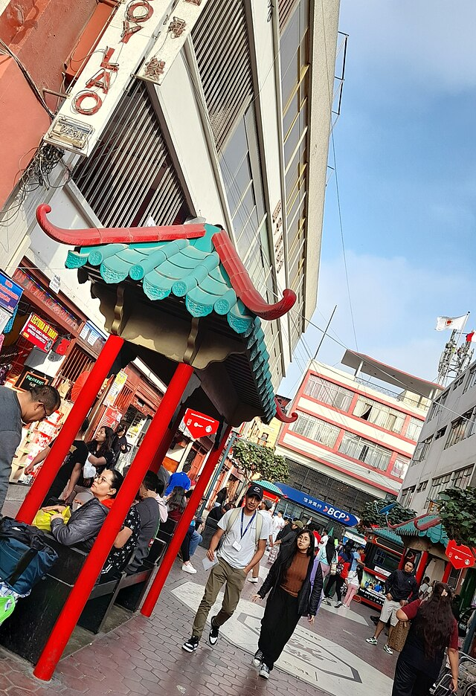
Barrio Chino, Lima, Peru
Photos by David Berkowitz and Epidemia2023x
Notes:
These images are open access from Wikimedia Commons:
https://commons.wikimedia.org/wiki/File:Calle_Capon_Pagoda_-_Lima%27s_Chinatown_-_Lima_Peru.jpg
https://commons.wikimedia.org/wiki/File:Barrio_Chino_de_Lima_2023.jpg

Slide 14
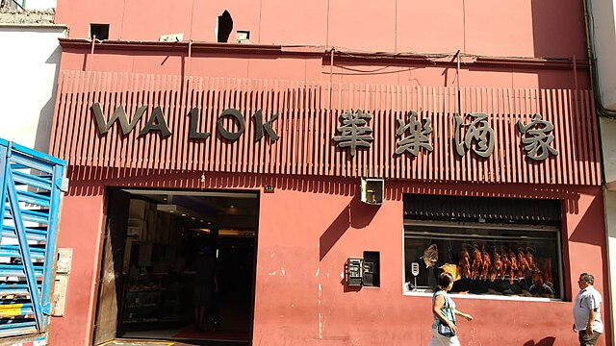
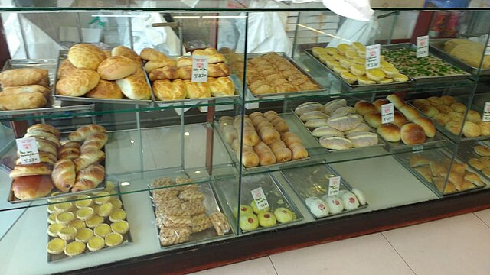
Barrio Chino, Lima, Peru
Photos by Miguel Alan CS
Notes:
These images are open access from Wikimedia Commons: https://commons.wikimedia.org/wiki/File:Wa_Lok.jpg
https://commons.wikimedia.org/wiki/File:Surtido_chifa_en_Wa_Lok_(02).jpg

Slide 15
6th Grade

Slide 16
Chinese Immigration to Peru

Slide 17
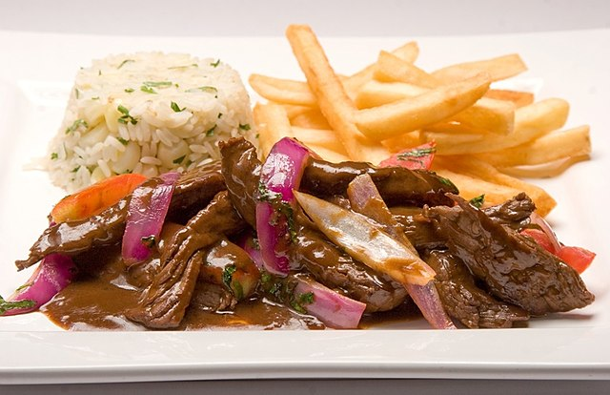
Lomo Saltado, the official dish of Peru
Notes:
This image is open access from Wikimedia Commons: https://commons.wikimedia.org/wiki/File:Lomo-saltado-perudelights.jpg

Slide 18
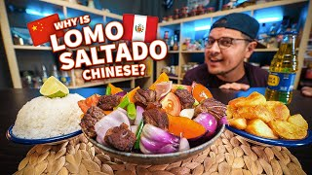
P

Slide 19
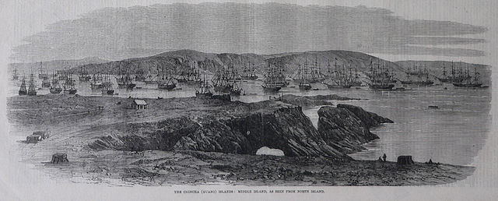
Guano deposits in Chincha Islands, Peru
Notes:
Chincha Islands, where large deposits of guano were located, courtesy of Manuel González Olaechea y Franco and The Illustrated London News https://library.brown.edu/create/modernlatinamerica/chapters/chapter-6-the-andes/moments-in-andean-history/chinese-peru/

Slide 20
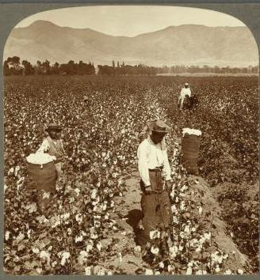
Chinese laborers in Peru, circa 1900
Notes:
Chinese Laborers in Peru circa 1900 https://library.brown.edu/create/modernlatinamerica/chapters/chapter-6-the-andes/moments-in-andean-history/chinese-peru/

Slide 21
Barrio Chino, Lima, Peru
Photos by David Berkowitz and Epidemia2023x
Notes:
These images are open access from Wikimedia Commons:
https://commons.wikimedia.org/wiki/File:Calle_Capon_Pagoda_-_Lima%27s_Chinatown_-_Lima_Peru.jpg
https://commons.wikimedia.org/wiki/File:Barrio_Chino_de_Lima_2023.jpg

Slide 22
Barrio Chino, Lima, Peru
Photos by Miguel Alan CS
Notes:
These images are open access from Wikimedia Commons: https://commons.wikimedia.org/wiki/File:Wa_Lok.jpg
https://commons.wikimedia.org/wiki/File:Surtido_chifa_en_Wa_Lok_(02).jpg

Slide 23
Chinese Immigration to Mexico

Slide 24
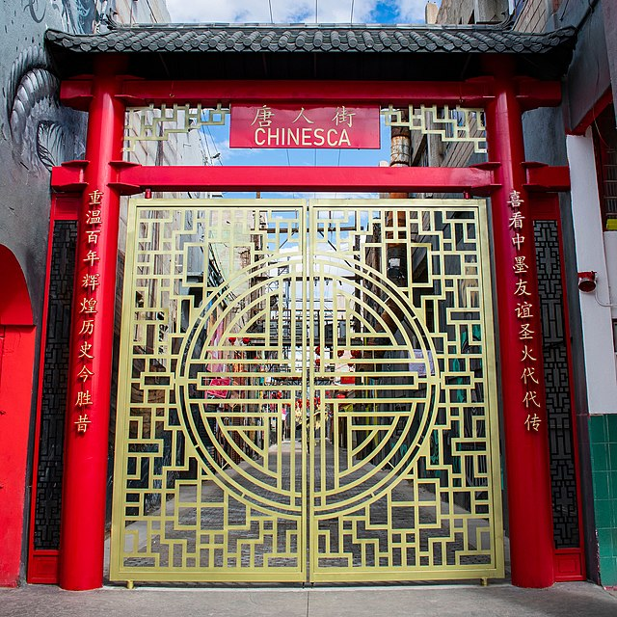
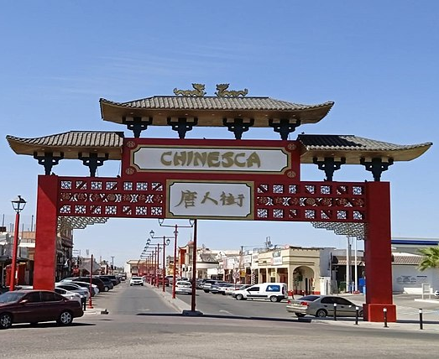
Entry Gates to La Chinesca, Mexicali, Mexico
Photos by Tyrv and Tacicuri
Notes:
These images are open access from Wikimedia Commons:
https://upload.wikimedia.org/wikipedia/commons/thumb/8/8c/Chinesca.jpg/640px-Chinesca.jpg
https://upload.wikimedia.org/wikipedia/commons/thumb/1/1a/Acceso_a_la_Chinesca_en_2022.jpg/640px-Acceso_a_la_Chinesca_en_2022.jpg

Slide 25
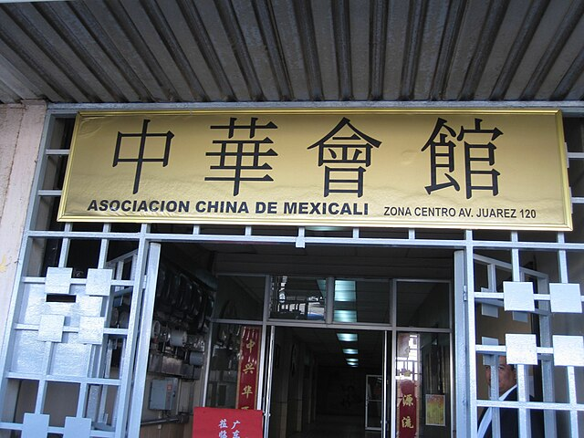
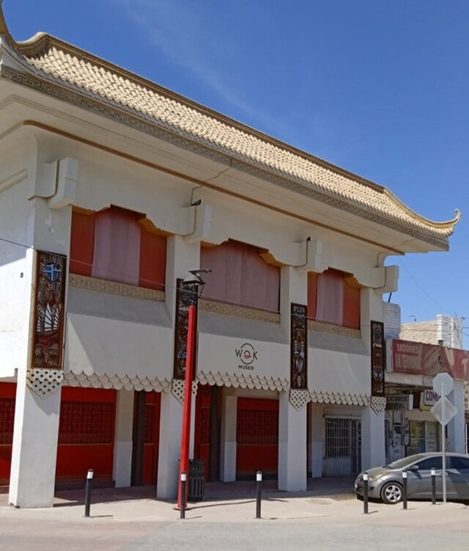
Entry Gates to La Chinesca, Mexicali, Mexico
Photos by Meiguoren and Tacicuri
Notes:
These images are open access from Wikimedia Commons:
https://upload.wikimedia.org/wikipedia/commons/thumb/3/3e/ChinaAssociationofMexicali.jpg/640px-ChinaAssociationofMexicali.jpg
https://upload.wikimedia.org/wikipedia/commons/thumb/f/ff/Museo_Wok_en_Chinesca_Mexicali.jpg/640px-Museo_Wok_en_Chinesca_Mexicali.jpg

Slide 26
Barrio Chino, Mexico City, Mexico
Photos by Juan Carlos Fonseca Mata
Notes:
These images are open access from Wikimedia Commons: https://commons.wikimedia.org/wiki/File:Paifang_del_Barrio_Chino,_Calle_de_Dolores,_Ciudad_de_M%C3%A9xico.jpg
https://commons.wikimedia.org/wiki/File:Barrio_Chino,_Ciudad_de_M%C3%A9xico_-_Adornos.jpg

Slide 27
Barrio Chino, Mexico City, Mexico
Photos by Beatriz Zarzosa and Juan Carlos Fonseca Mata
Notes:
These images are open access from Wikimedia Commons:
https://commons.wikimedia.org/wiki/File:Barrio_Chino_CIudad_de_Mexico.jpg

Slide 28
Anti-Chinese Political Cartoons in Mexico

Slide 29
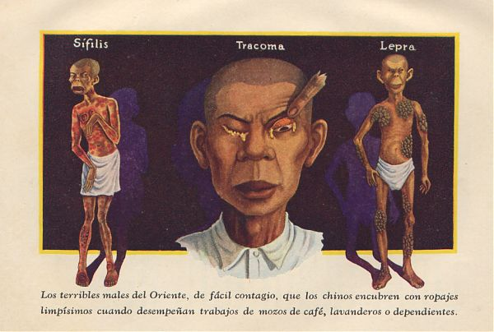
Cartoon by José Ángel Espinoza depicting Chinese as Carriers of contagious diseases: “The terrible men of the East, easily contagious, that the Chinese mask with spotless clothes when they work as waiters, launderers, or dependents.”

Slide 30
Cover and feature article from the illustrated magazine Sucesos Para Todos (“Events for All”), Number 185, published in summer 1936. The cover text and article headline state, “How the Chinese mafias operate in Mexico.”
Notes:
Image from Itzayana Gutiérrez Arillo’s dissertation (pages 87-88), available at https://escholarship.mcgill.ca/concern/theses/3x816s83g?locale=en

