Slide 1
The Ghadar Party
By Dr. Noreen Naseem Rodríguez
nrdz@msu.edu

Slide 2
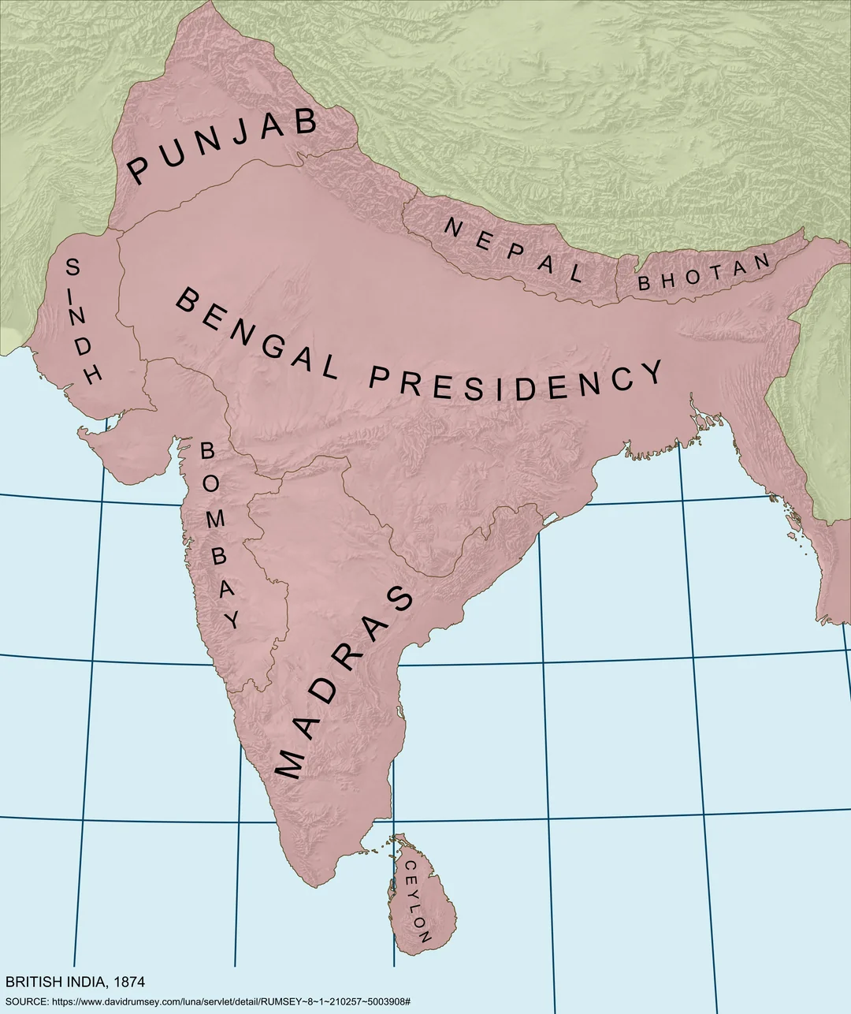
The British Raj
From 1858 until 1947, Great Britain ruled the Indian subcontinent under what was known as the British Raj. But throughout Britain’s rule, Indians resisted, although this history of anti-colonial resistance and activism abroad–including in the United States–is rarely taught.

Slide 3
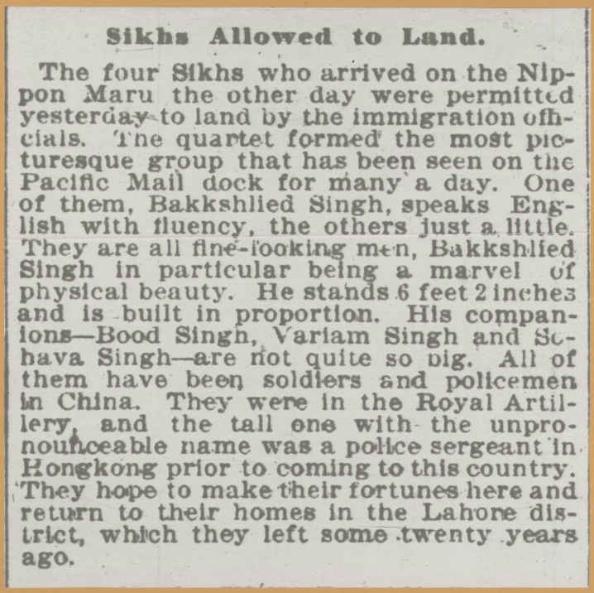
Early Indian Immigration to the United States
The San Francisco Chronicle (shown on right) announced the arrival of four Sikh men in San Francisco on April 6, 1899, making the group the first recorded South Asian immigrants in California. Sikh men from the Punjab region of India (which at the time consisted of the areas now known as Pakistan and Bangladesh) began to immigrate to the U.S. in the early years of the 20th century.

Slide 4
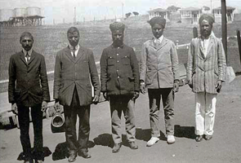
Early Indian Immigration to the United States
Most Indian immigrants were men who arrived in the U.S. in the early 1900s arrived between 1907 and 1910, with a peak population of 7,000. Approximately 90% of these immigrants were Sikh, 10% were Muslim, and a few were Hindu. Despite these distinct religious identities, Indian immigrants were classified as Hindus (also spelled “Hindoo) in the 1920, 1930, and 1940 U.S. Censuses. This is the only documented instance of religious affiliation being used as a racial category. From 1950-1970, the category was omitted. In 1980, the Census introduced “Asian Indian” as an ethnic category.
Five Indian immigrants at Angel Island in 1910. Courtesy of California State Parks.

Slide 5
Click here to visit the interactive version of this timeline.

Slide 6
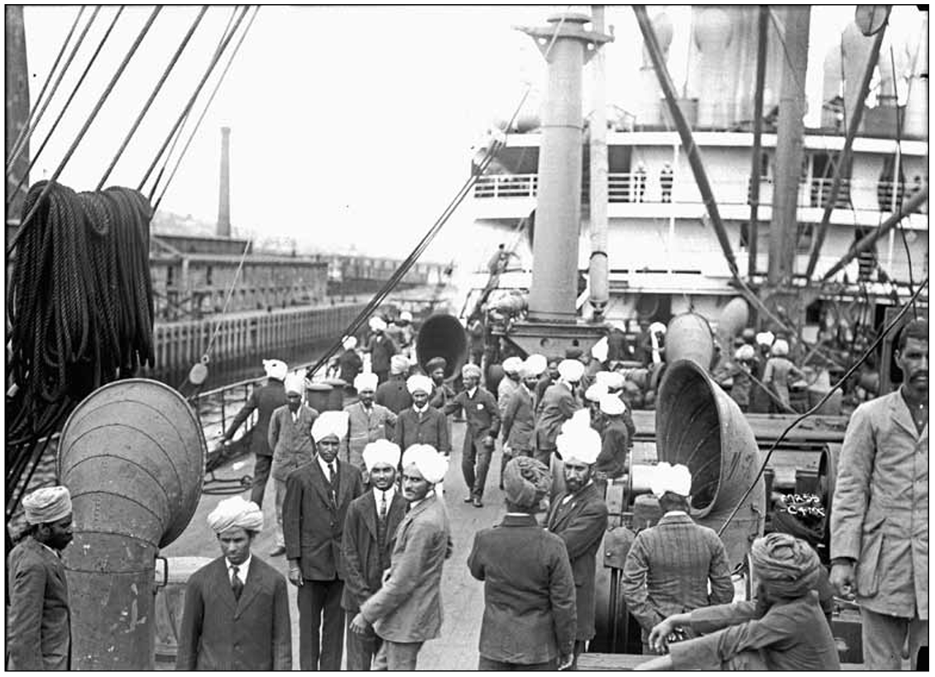
The S.S. Minnesota arrives in Seattle, Washington, on June 23, 1913. The term “tide of turbans” was a common pejorative used when speaking of migration from India, with the turban itself becoming a symbol for, and target of, anti-immigrant sentiments.
Photo from Washington State Historical Society in Ogden (2012), p. 167

Slide 7
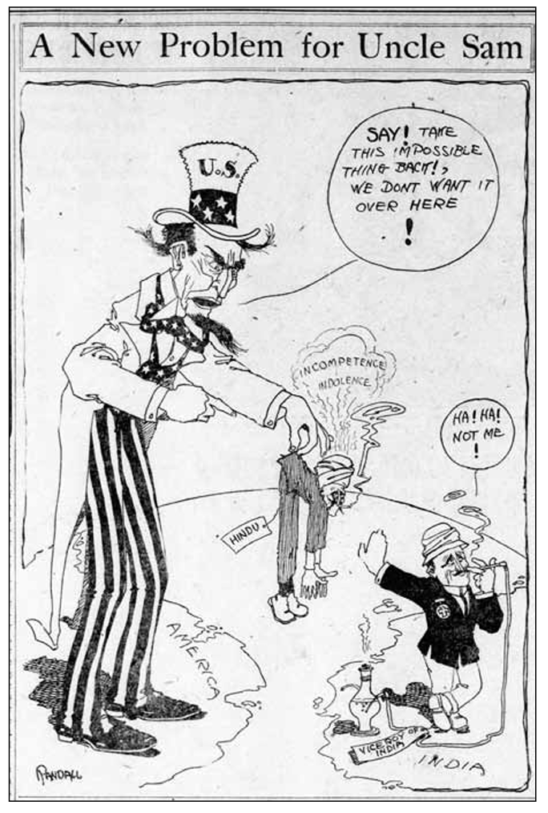
The “Hindu” Problem
The political cartoon on the right is from the August 13, 1910 issues of the San Francisco Call, a popular newspaper. What does it show about popular attitudes toward Indian immigrants, aka Hindus? How does this compare to political cartoons from the 1800s about Chinese immigrants and laborers (see next slide)?
Image from Ogden (2012), p. 171

Slide 8
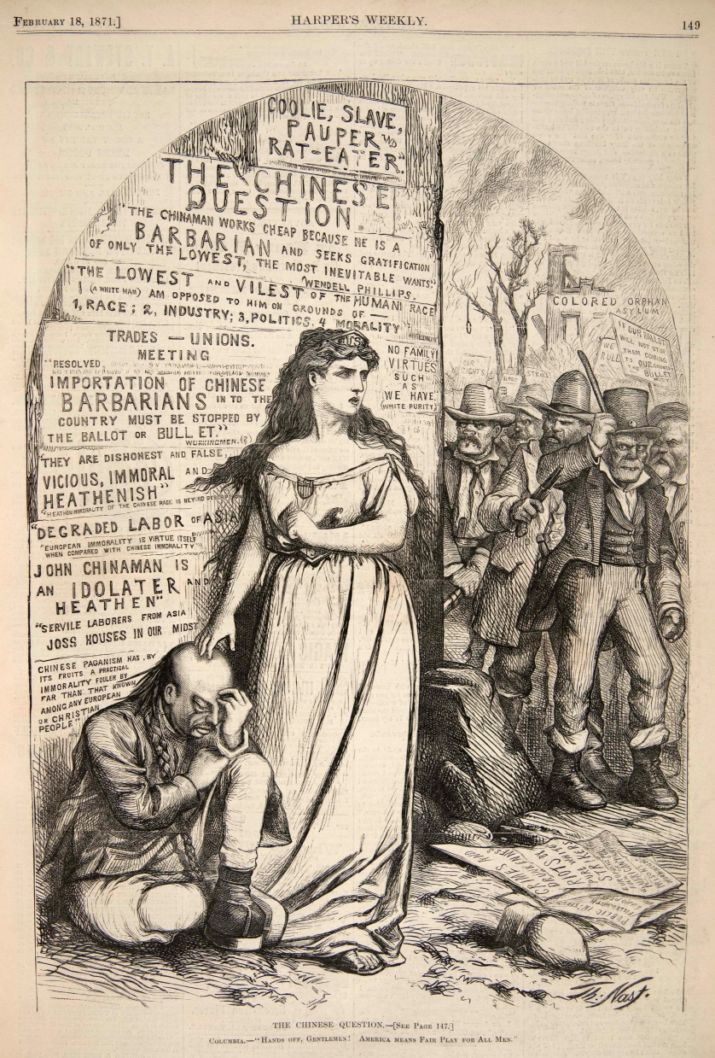
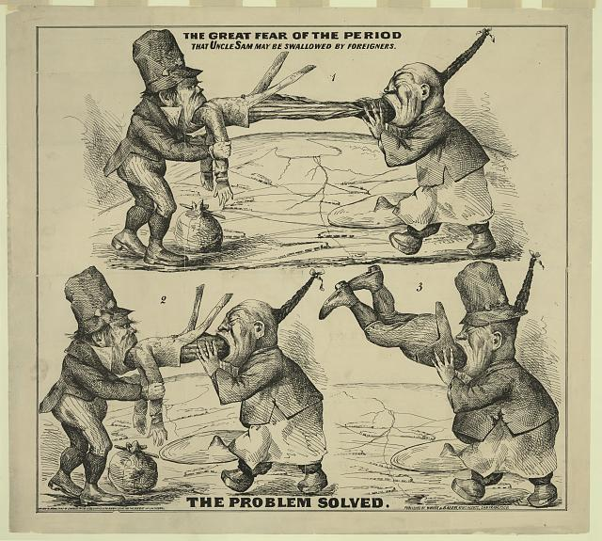
The Great Fear of the Period (1860s) and The Chinese Question (1871)
Notes:
https://www.loc.gov/resource/pga.03047/
https://thomasnastcartoons.com/2016/02/13/the-chinese-question/

Slide 9
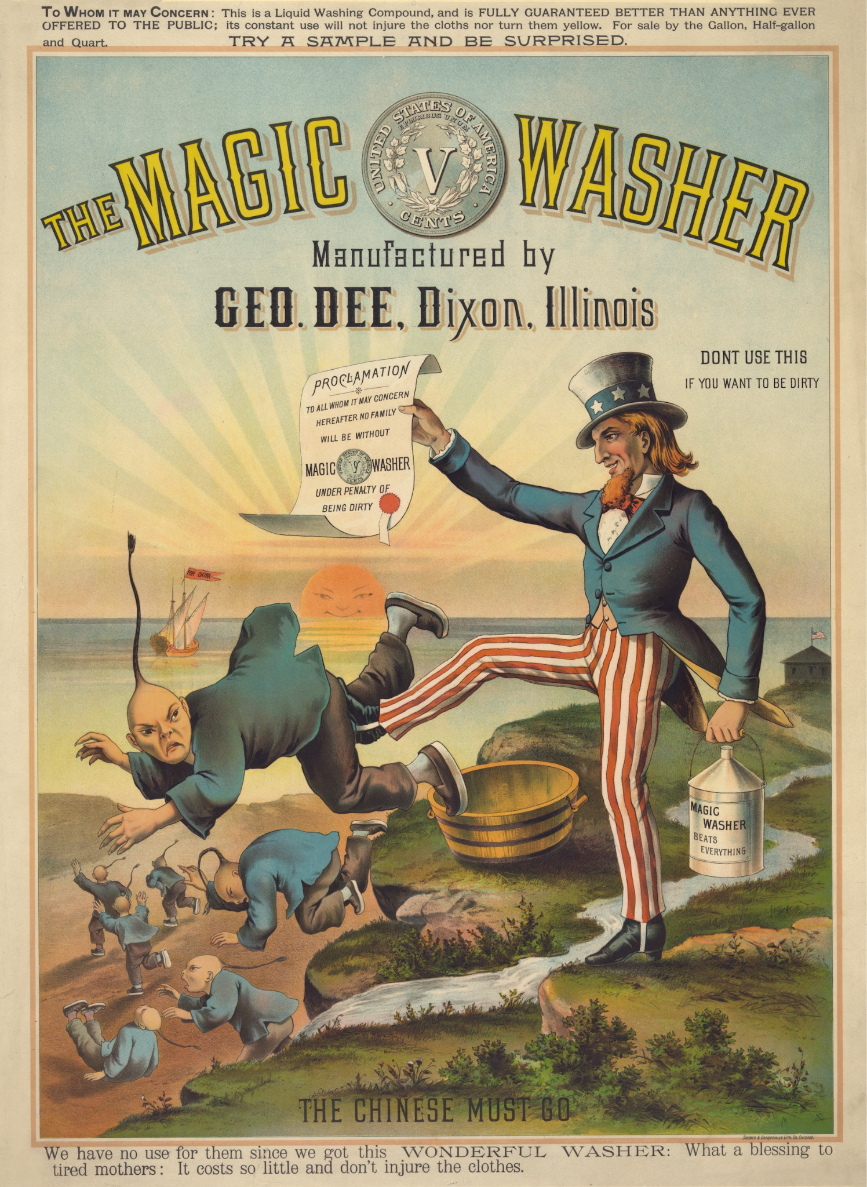
Notes:
https://en.wikipedia.org/wiki/Uncle_Sam_Kicks_Out_Chinaman#/media/File:The_Chinese_Must_Go_-_Magic_Washer_-_1886_anti-Chinese_US_cartoon.jpg

Slide 10
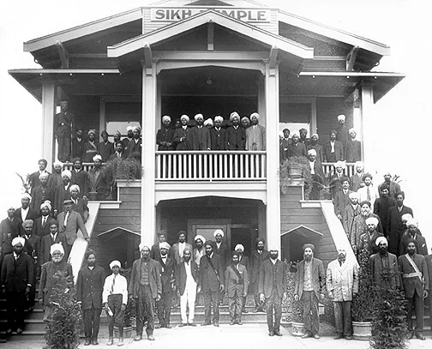
Dehumanization at Home and Abroad
As Sikhs from India began to immigrate to the U.S. and Canada, they faced racial discrimination similar to their experiences with colonial subjugation in their homeland. Frustrated by their unjust treatment in their new homes, Sikh immigrants along the Pacific Coast began to organize and resist the ongoing dehumanization that they attributed to colonialism.
Several publications detailed the restrictive immigration laws and discrimination faced by Indian immigrants as well as the need for revolution in their motherland. These messages of revolution were viewed as seditious threats to British officials, who soon worked with U.S. and Canadian officials to surveil Sikh immigrants.
Indian migrants at the Stockton Gurdwara in the early 1920s. Courtesy of Wikipedia, https://tinyurl.com/3jt2esbn.

Slide 11
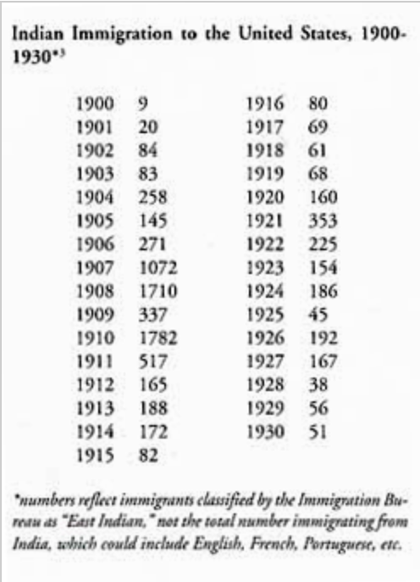
The Ghadar Party
In 1913, Punjabi migrant workers and Bengali and Punjabi intellectuals and students who felt pushed out of India due to colonialism and now faced racist humiliation in North America came together to form the Ghadar Party. Ghadar, Urdu for “revolt” or “rebellion,” represented the coalition’s name and their goal to attain racial equality in the U.S. and Canada (and beyond) alongside an independent India. The Ghadar Party focused on unity and secularism among those of Indian descent, favoring a collective national identity instead of focusing on religion, caste, or region of origin. Months after the Ghadar Party’s creation, it had over 5,000 members and branches across the world, from Stockton, California to Panama and Shanghai. 90% of Ghadar Party members were Punjabi Sikh men, half of whom had served in the British Indian Army.
Table from U.S. Bureau of Naturalization

Slide 12
Ghadar!
The Ghadar Party published a newspaper of the same name that encouraged readers to circulate as many copies of the newspaper to fellow Indians was their patriotic duty. With its anti-colonial focus, the paper was banned immediately in India when the first issue arrived on December 7, 1913. Indian officials searched luggage from the U.S., seizing Ghadar publications as contraband. By 1914, nearly 5,000 copies of Ghadar, published in Gurmukhi and Urdu, were circulated weekly for free, funded by local Indians. Readership spanned east Asia as well as parts of Africa and South America, and readers there would send copies of Ghadar to India. That same year, the Ghadar Press published 12,000 copies of Ghadar-di-Gunj (Echoes of Mutiny), a collection of poetry and protest songs in Urdu and Punjabi that were often performed at Ghadar gatherings. These two publications connected and mobilized Indians worldwide as they exposed the exploitation and brutality of British imperialism in the Raj and beyond, leading some members to return to Punjab and attempt an armed revolt known as the Ghadar Mutiny. These efforts were unsuccessful, and Ghadarites were tried for several anti-colonial actions.

Slide 13
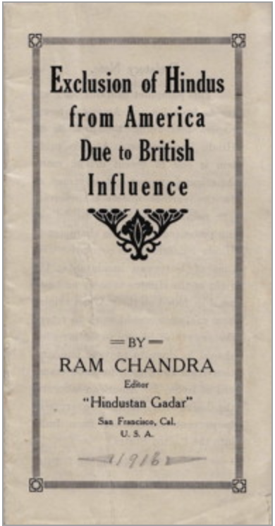
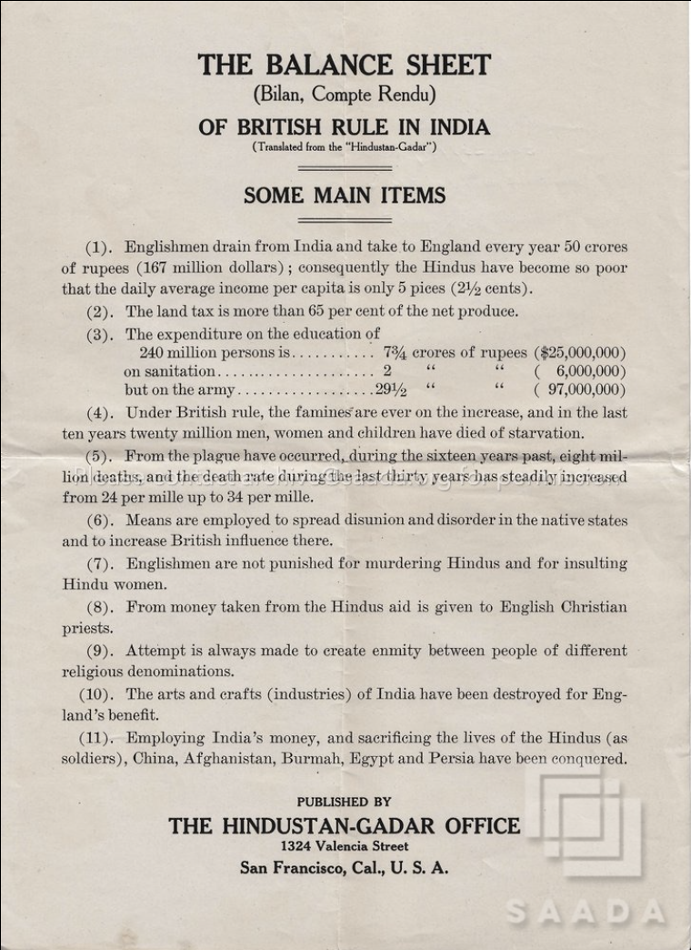
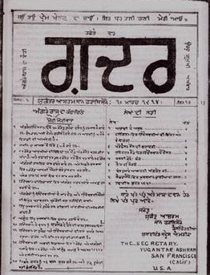
Ghadar
Publications
Notes:
Left image from FoundSF

Slide 14
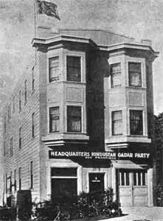
Ghadar Party Headquarters
The Ghadar Party began operations at 436 Hill Street in San Francisco in 1913. The location was known as "Yugantar Ashram" - ashram is Hindi for a monastery or religious retreat. The weekly “Ghadar" publication began here. In 1917, the Party’s headquarters moved to 5 Wood Street, where it became referred to as "Ghadar Ashram". The building and its contents were handed over to the Indian Consulate in 1949. The building was restored and the Ghadar Memorial was inaugurated by Shri T.N. Kaul, India’s Ambassador to the United States, in March 1975. The following year, the Ghadar Memorial Library was established and has a collection of Hindi & English books.
Notes:
Image from https://www.cgisf.gov.in/page/gadar-memorial-hall/

Slide 15
Surveillance of the Ghadar Party
Concerned by the Ghadar Party’s anti-colonial efforts, British officials worked closely with immigration offices in San Francisco, Seattle, and Portland to exclude and expel individuals they considered political radicals. The British government pressured the U.S. to refuse asylum to Indian revolutionaries and sent lists of publications and Indian immigrants they considered seditious to the State Department and the commissioner-general of immigration. Soon, both British and U.S. officials viewed Indian immigrants as having subversive political agendas. Across the globe, U.S. diplomats tried to forbid any Indian with anticolonial leanings from leaving India and, if successful, from landing at U.S. immigration stations.

Slide 16
The End of the Ghadar Party
Ghadarites became disillusioned with the U.S. alliance with Britain during World War I, recognizing the hypocrisy of a nation claiming to fight a war in the name of democracy while continuing to dehumanize Black Americans and Asian immigrants at home. In an important show of cross-racial solidarity, the National Association for the Advancement of Colored People (NAACP) published reports in its magazine The Crisis about the Indian independence movement and efforts by the Justice Department to deport 6 Indians. This alarmed U.S. intelligence officials, who then increased their surveillance on both Black and Indian communities for decades. After World War I, the Ghadar Party began to split into different factions. Some Ghadarites in New York created the Friends of Freedom for India organization, which included Indians and white activists, while others who viewed Soviet Russia as a model society joined the international communist movement. By 1926, the Ghadar Party in California was at its most active and continued to organize meetings and collect money for political outreach in India across the state. Two decades later, the party formally dissolved after Indian independence was finally achieved in August 1947.

Slide 17
The Bellingham Riots
Optional Extension

Slide 18
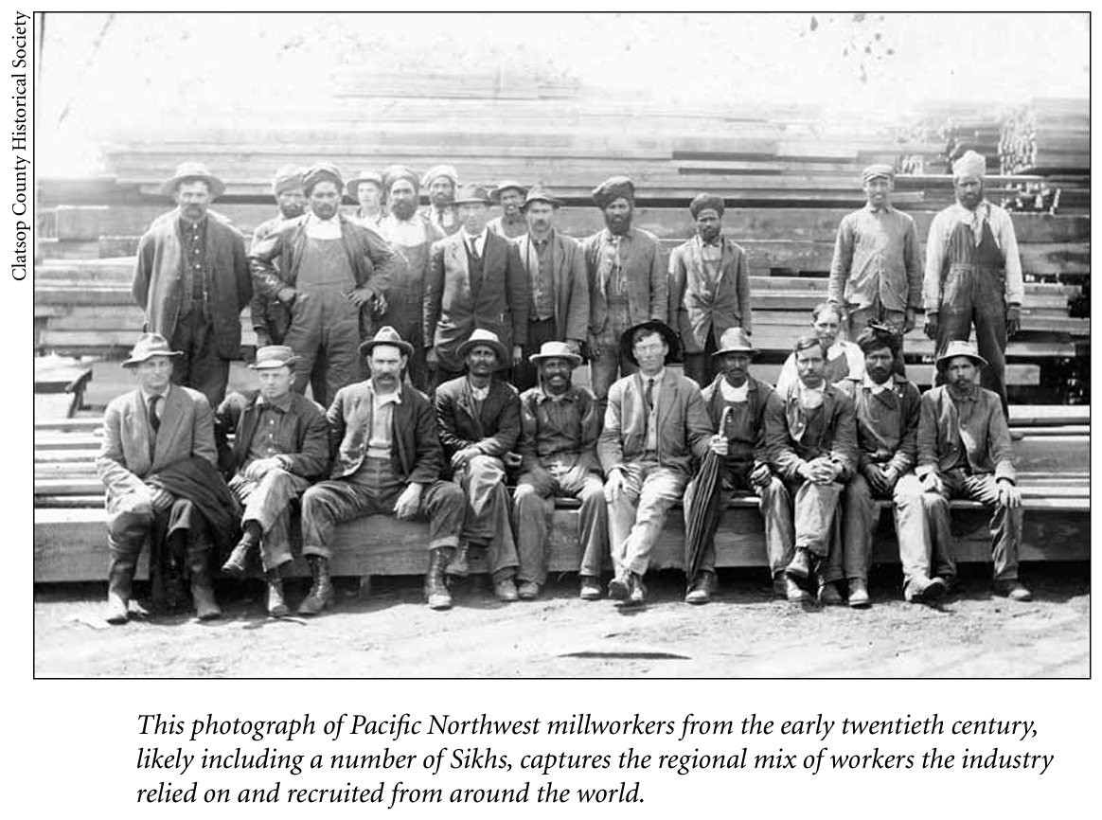
From Ogden (2012) p. 168

Slide 19
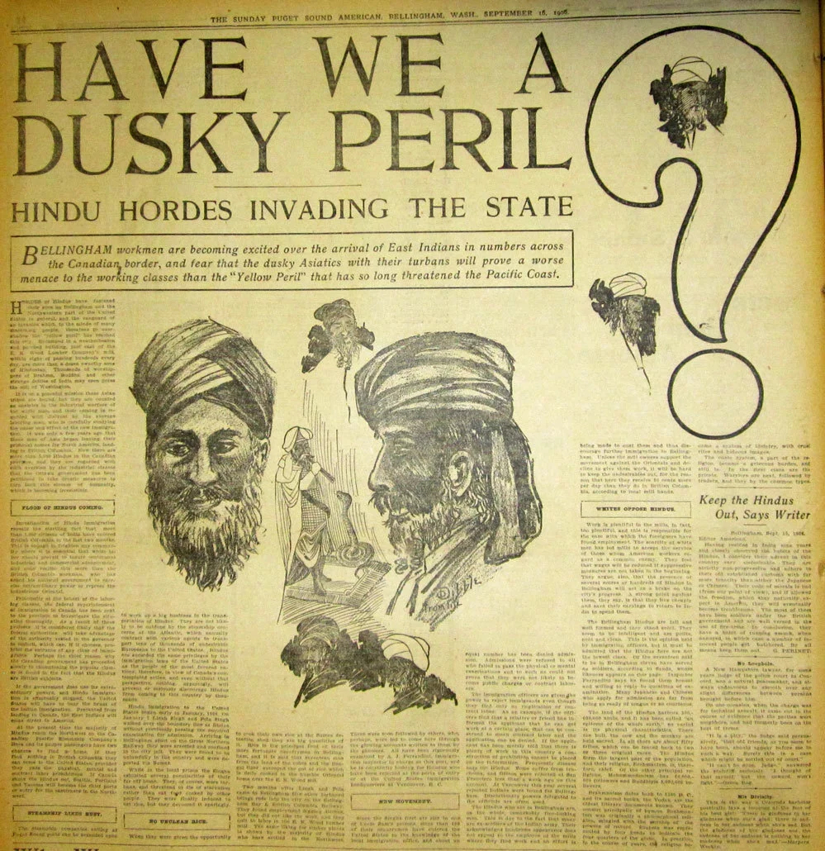
Article from the 16 September 1906 Puget Sound American newspaper incorrectly describing turbaned Sikhs as "Hindu" and their unfavorable immigration to Bellingham.
Image from Wikipedia
More information and primary sources about the Bellingham Riots can be found in this post by David Cahn by the Seattle Civil Rights and Labor History Project at the University of Washington.

Slide 20
“We Are Not Strangers” Documentary

Slide 21
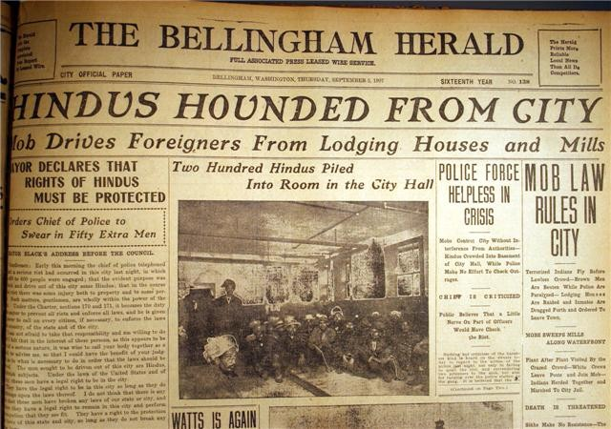
Front page of Bellingham Herald the day following the riot. Source: http://www.wce.wwu.edu/resources/AACR/documents/bellingham/main/1.htm

Slide 22
Punjabi-Mexican Families
Optional Extension

Slide 23
Immigration Act of 1917
This act was the first widely restrictive immigration law for several reasons:
Immigrants over 16 years old were required to pass a literacy test
Immigrants had to pay higher taxes upon their arrival
Immigration officials had more discretion over who they could exclude from entry
An “Asiatic Barred Zone” was designated from which no immigrants were allowed; China, Japan, and the Philippines were the only nations excluded but other restrictions were in place for those immigrants.
Most Punjabis who immigrated to the U..S. were men, and many had left their wives and children behind in India. In Yuba City before World War 1, there were only 4 Punjabi women! In 1930, there were only 100 South Asian women per 1,572 South Asian men. The 1917 Immigration Act made it impossible for Punjabi men to sponsor their families, keeping them separated until the laws changed decades later.

Slide 24
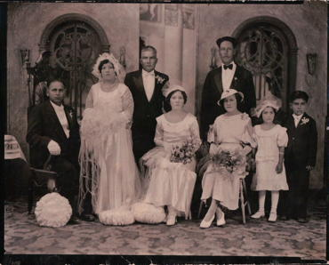
Punjabi-Mexican Families
Many Mexican women who immigrated to the United States during and after the Mexican Revolution worked in the fields of Southern California alongside Punjabi men from India. At the time, anti-miscegenation laws prevented non-white immigrants from marrying white people. This led to several Punjabi-Mexican relationships beginning in 1916 where Sikh men and Catholic women blended religions, cultures, and languages. By 1946, there were 378 Punjabi-Mexican marriages in California.
Punjabi-Mexican Wedding from the Amelia Singh Netervala Collection at the South Asian American Digital Archive

Slide 25
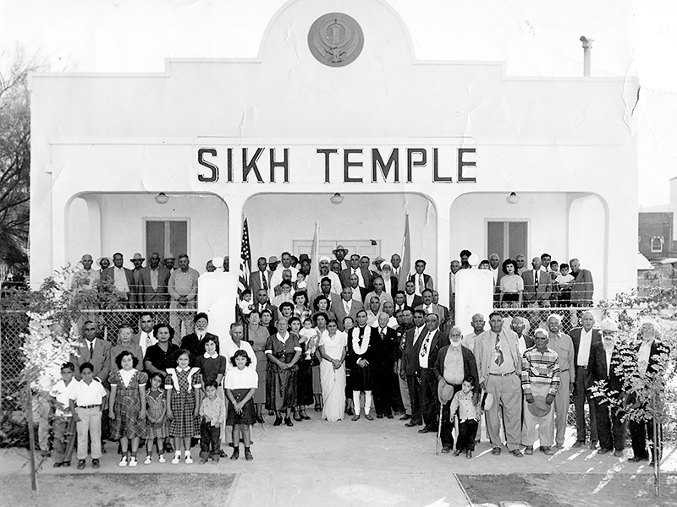
The El Centro, Calif. Sikh Temple, photographed in 1951.
Source: https://earthjustice.org/blog/2021-may/how-asian-american-farmers-shaped-our-cultural-food-landscape

Slide 26
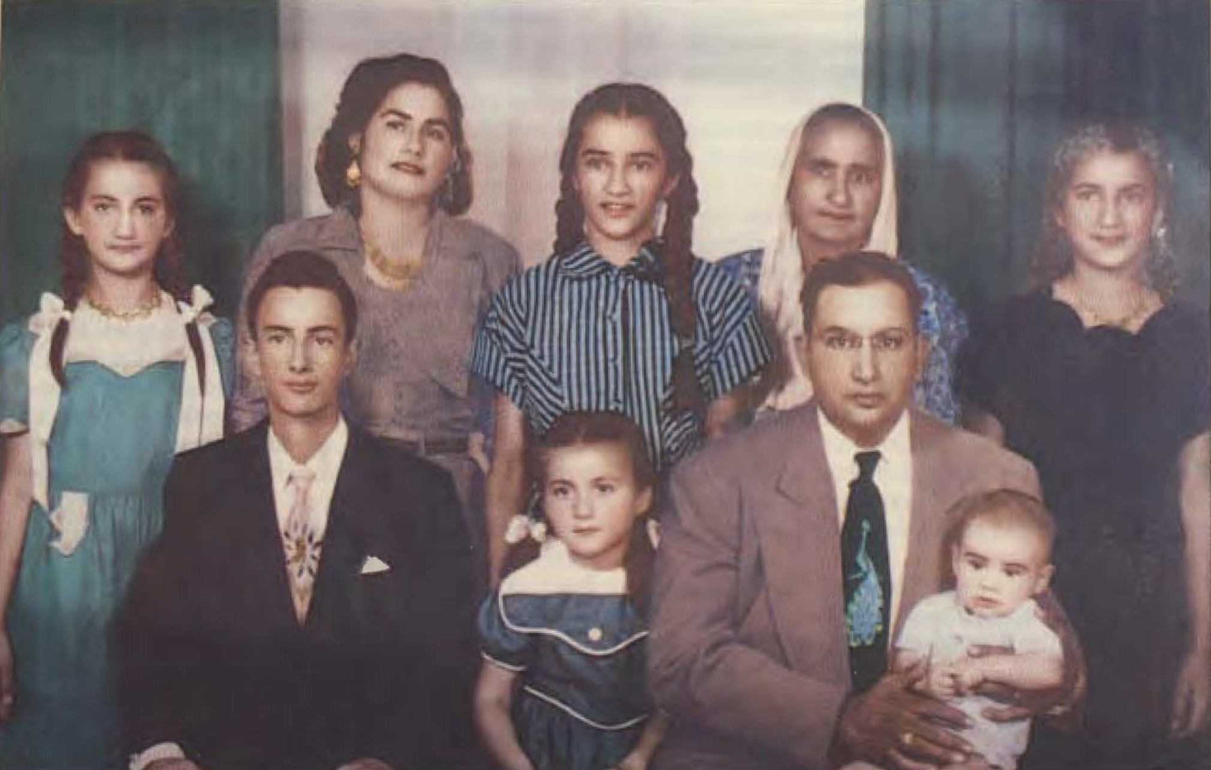
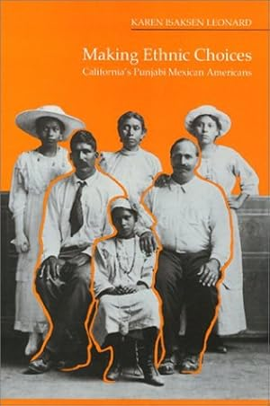
Media about Punjabi-Mexican Families
VIDEOS:
Roots in the Sand
The Punjabi-Mexicans of California
Mexican Punjabis in California and Texas
The History of California’s Punjabi Mexican Communities at Latina.com

Slide 27
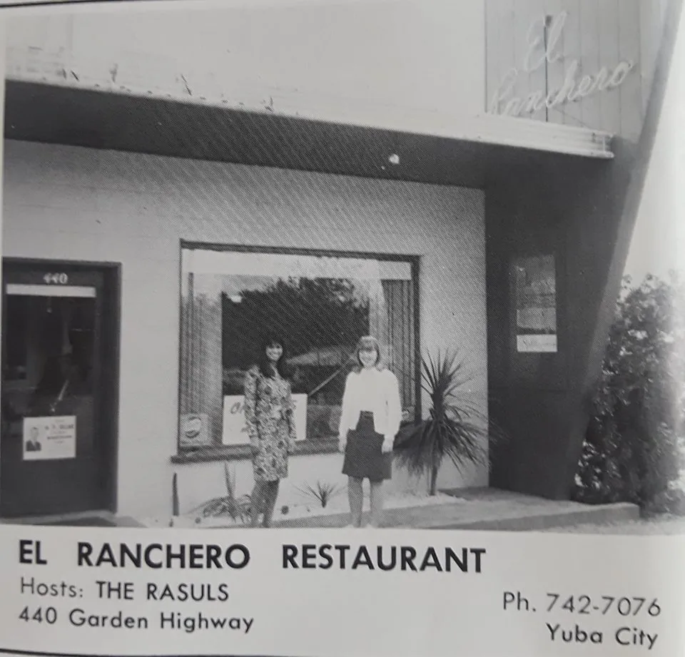
El Ranchero: Punjabi-Mexican Fusion Food
El Ranchero, later renamed Rasul’s El Ranchero, opened in Yuba City, California in 1954. Gulam Rasul and his wife Inez left behind fieldwork to open their own restaurant, which operated for four decades. One of El Ranchero’s signature dishes was the roti quesadilla, which fused classic Punjabi and Mexican dishes and was sometimes called “Hindu Pizza” despite Rasul being Muslim.
Left: Ad for El Ranchero — printed as “El Rancho” in error here — in the July 1, 1977 issue of the Appeal-Democrat newspaper. Above: Ad for El Ranchero in the Yuba High School 1966 yearbook, both images from Eater

Slide 28
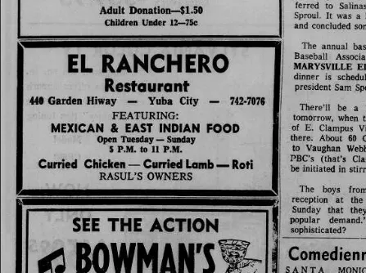
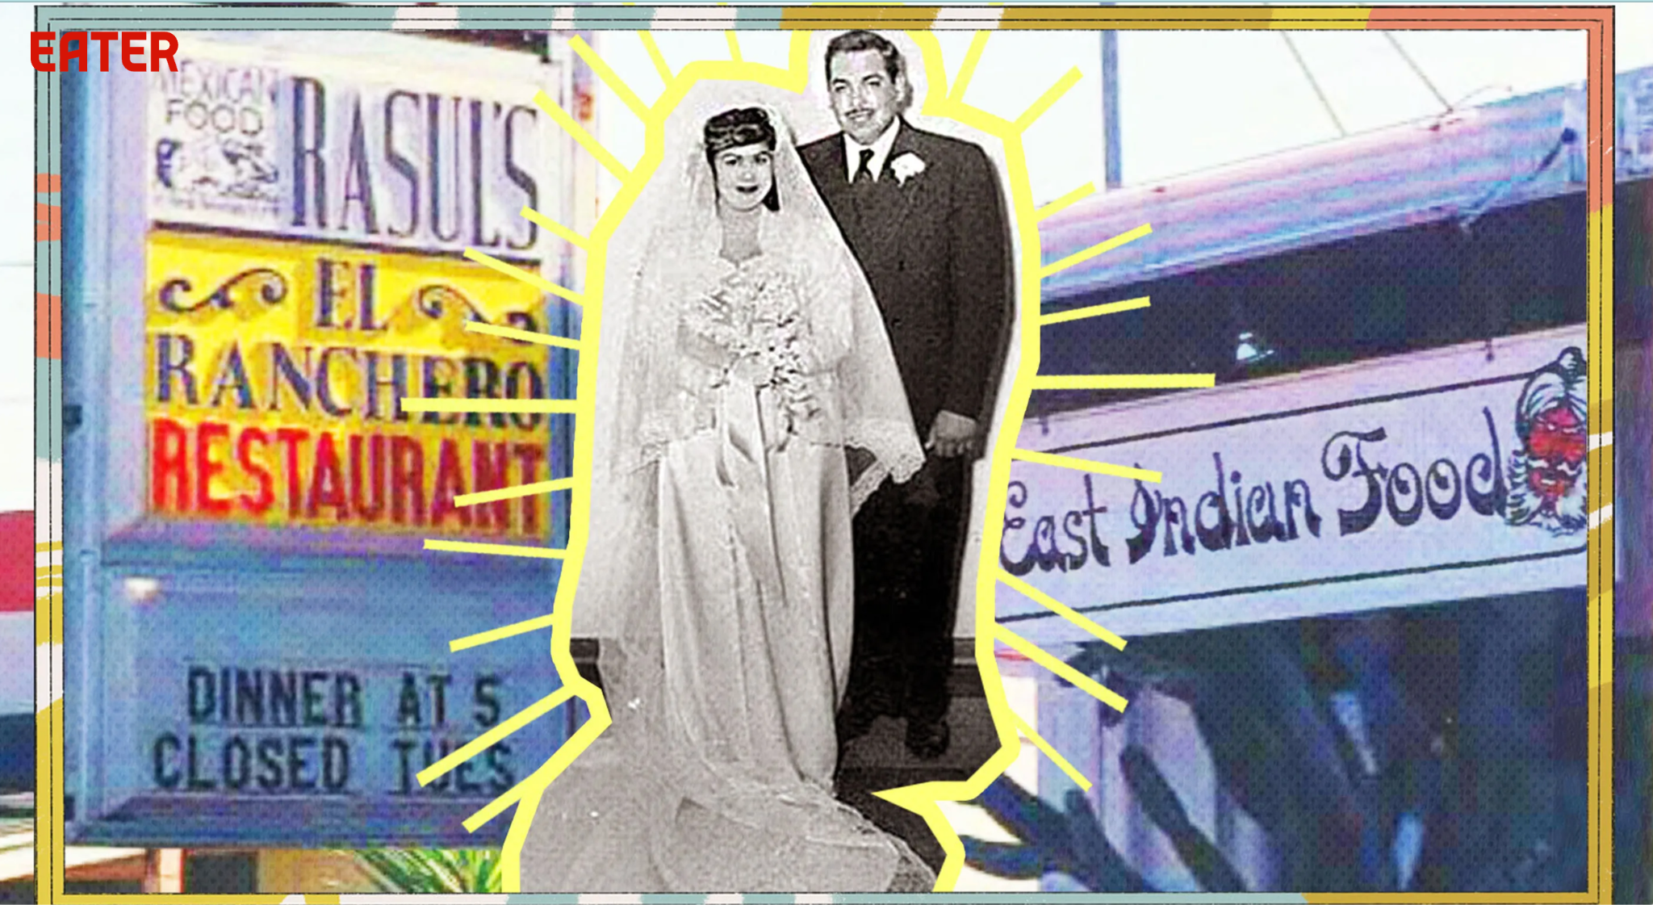
Ad for El Ranchero in the September 12, 1969 issue of the Appeal-Democrat newspaper

Slide 29
References
Punjabi and Sikh Diaspora Digital Archive
Arrival and Early Years
South Asian American Digital Archive
Gadar Party Primary Sources
Bhatia, N. (N.D.). India’s Ghadar Party Born in San Francisco. FoundSF: The San Francisco Digital History Archive.
Ogden, J. (2012). Ghadar, Historical Silences, and Notions of Belonging. Oregon Historical Society.
Sohi, S. (2014). Echoes of Mutiny. Oxford University Press.

